Slide 1
Central Executive Officers.
CEOs’ Excessive Pay.

Slide 2
History.
The payment of CEO’S has raised controversy in the USA for more than a century.
The history of the high remunerations and payment of CEOs’ can be traced back from the 1940’s.
Between 1940 and 1970, the average payment of CEO was below $ 1 million (Crystal, 2015).
The Economic Policy Institute asserts that this payment rose significantly from 1978.
From 1978-2013, the payment of CEO’s rose by a margin of 397% while the workers compensation grew by 10.2% only (Crystal, 2015).
By 2013, the average CEO’s payment for the 350 most profitable companies in the USA was $ 15.2 million.
Notes:
The controversy circulating the issue of CEO payment is brought about by the fact that co corporate management is a different profession from ownership. The modern debate over the high pay of CEO has been motivated by cases of economic inequalities and the period of moderation of executive payment. The payment of the CEOs’ is a subject to criticism and this is motivated by the fact that these executives benefit significantly from their employees whose lifestyle and payment is almost stagnant (Crystal, 2015). Cases of economic inequalities, recession or political challenges do not seem to hinder the payment of these executives.

Slide 3
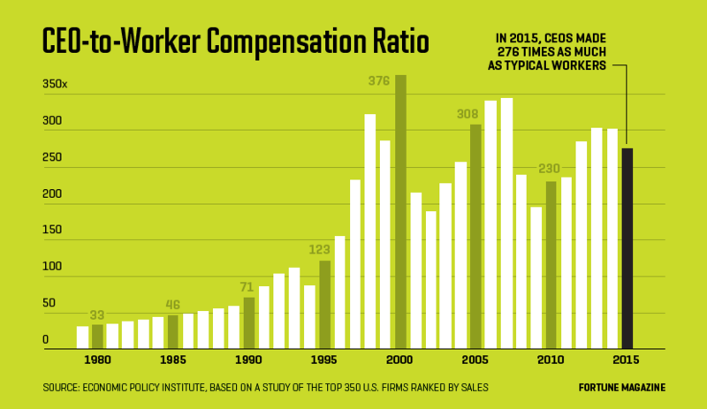
Out of control
In the 1970’s the payment of CEO’s was not as ridiculous as it is today.
In the early 1980’s CEOs' earned 30 times more than their employees. The payment of these executives got out of hand in the 1990’s. (Dow & Raposo, 2015).
Currently, CEOs' earn 276 times more than their employees.
Notes:
The graph above clearly illustrates the fact that the payment of CEOs' cannot be compared with that of their employees.
In the current society, politics have lead to polarization and an aspect of statement and hence, one would expect citizens to be upset by the high pay of CEO's but this is never the case. The political systems seem to favor the wealthy and hence, the CEOs’ benefit from these flaws. The payment of CEOs’ became an issue of discussion among members of the general public since the 1970’s but till today, nothing has been resolved (Dow & Raposo,2015). The employees will therefore require decades to receive a modest payment and improvement like their top executives.

Slide 4
References.
Crystal, G. S. (2015). Why CEO compensation is so high. California Management Review, 34(1), 9-29.
Dow, J., & Raposo, C. C. (2015). CEO compensation, change, and corporate strategy. The Journal of Finance, 60(6), 2701-2727.
http://fortune.com/2017/04/19/executive-compensation-ceo-pay/.

